Slide 1

Puppy Care™ Acquisition Analytics
December, 2018

Slide 2
Conversations and Bookings
December 2018

Slide 3
Who is more likely to leave a review?
Some stats
Total number of pet owners*: 23,099
Total number of service providers*: 8,927
Total number of reviews left by distinct pet owners: 18,358
Total number of reviews left by distinct service providers: 4,062
*only users with uncancelled/completed bookings are considered.
We need to be careful when determining who is more likely to leave a review. There are 3 times as many pet owners as providers. If we go by raw number of reviews pet owners would almost certainly win!
Percent of pet owners who leave reviews: 79.5%
Percent of service providers who leave reviews: 45.5%
December 2018

Slide 4
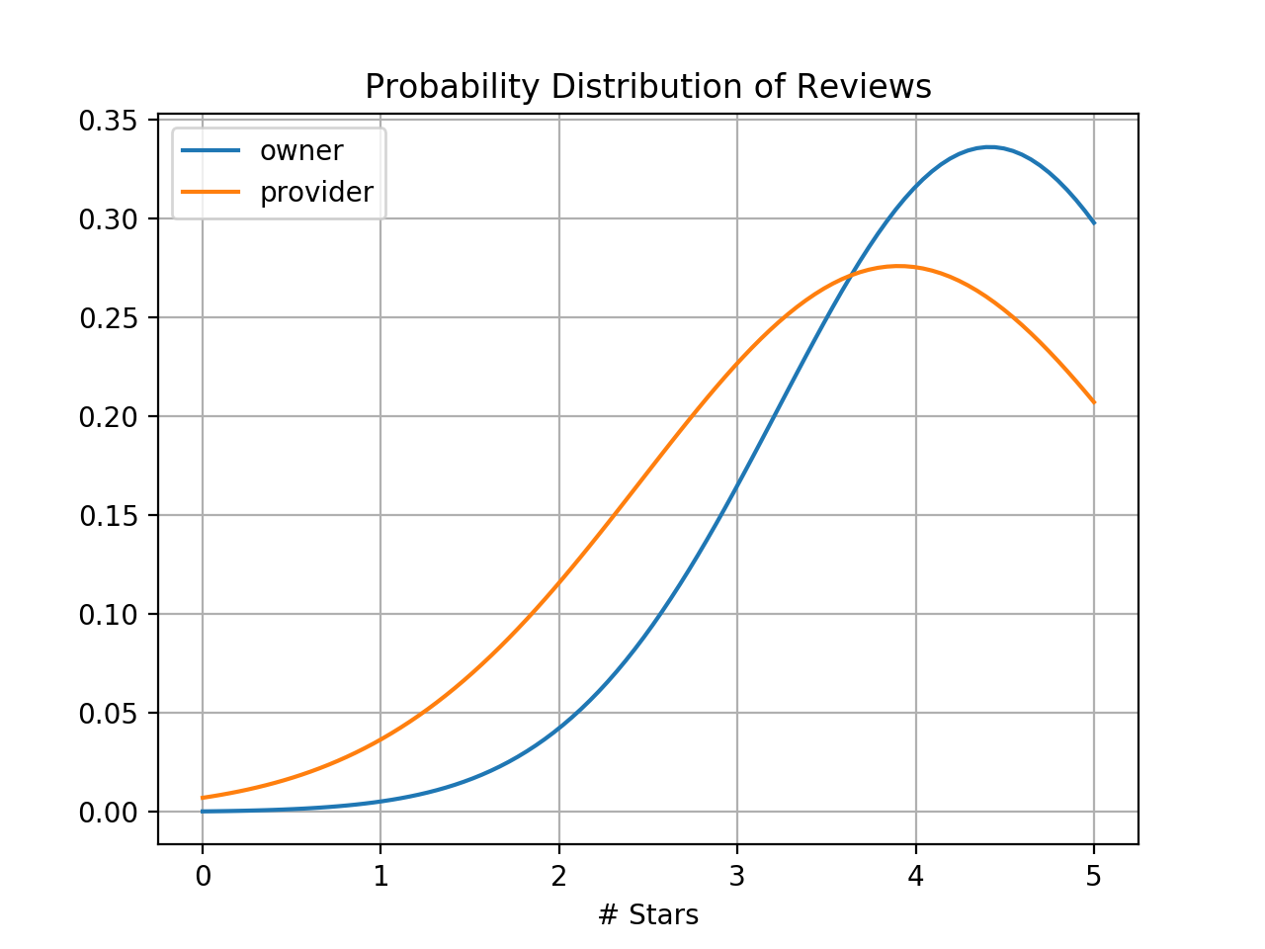
Who is more likely to leave a good review?
The plot on the right shows the distribution of stars left on reviews by providers (orange) and pet owners (blue)
As seen on the plot; the average provider review is lower than the average owner review.
Providers also have a much wider distribution, meaning they are more likely to give a variety of stars.
4.4
3.9
Since there are significantly less provider reviews, and the reviews are significantly lower on average, it seems as though providers only feel compelled to leave a review when they have a bad experience.
December 2018

Slide 5
Recent Daily Booking Rate
December 2018

Slide 6
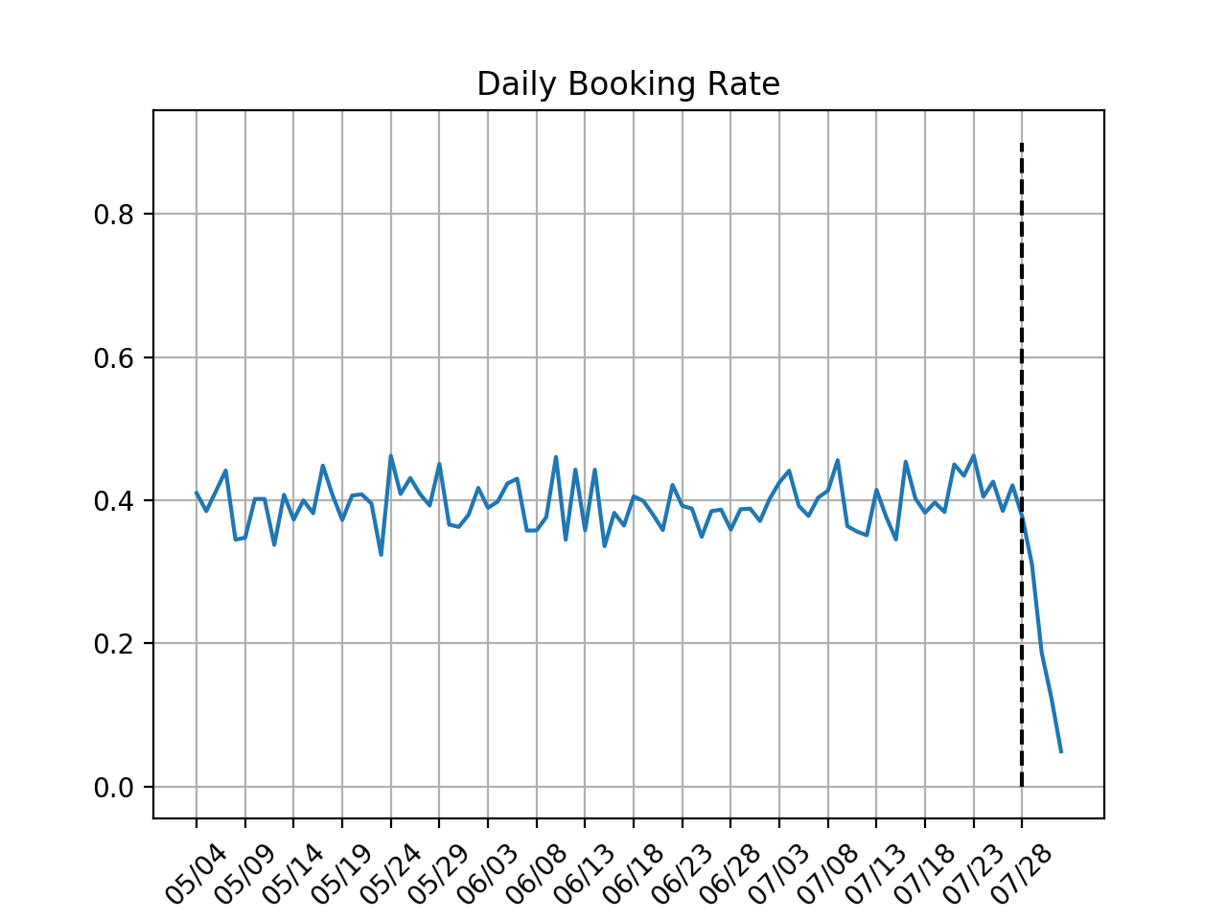
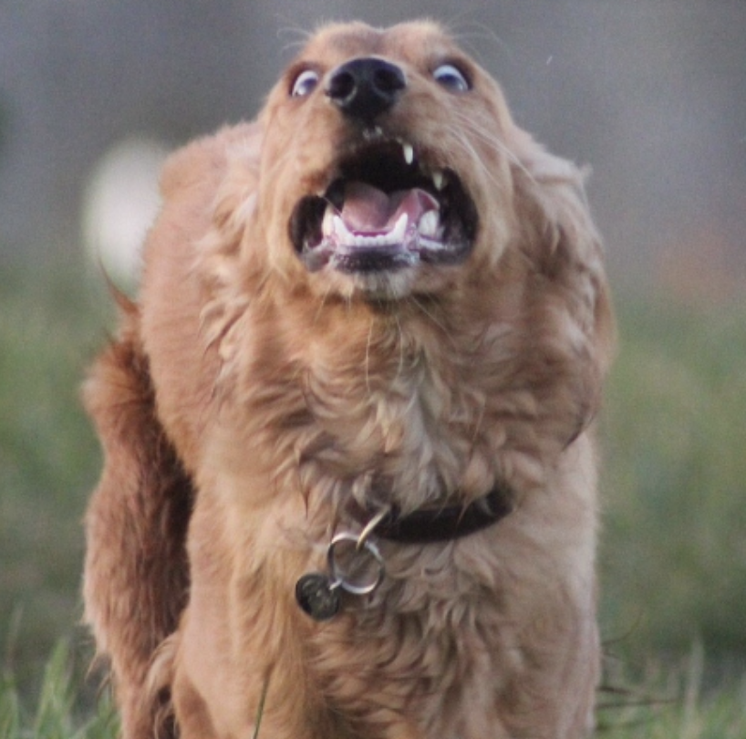

Booking Rate Daily Trend
The plot on the right shows the daily booking rate for the past 90 days.
Successful booking rate has been steady at around 40% ($±$5%).
Steep drop off in booking rate is seen in the last 4 days!
December 2018

Slide 7
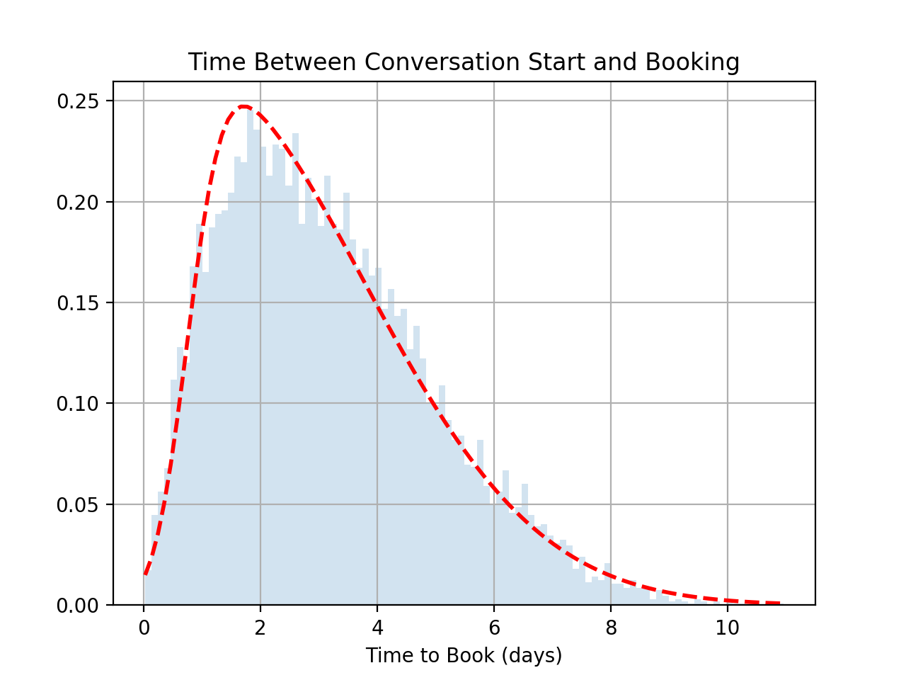
Average Booking Delay
But wait! Booking doesn’t happen the instant a conversation starts…
The plot on the right shows the average number of days between a conversation start and a successful booking.
It’s difficult to find the mean delay due to the Landau distribution.
One way to look at this is: a 6 day delay would account for roughly 90% of bookings.
When determining if a conversation leads to a successful booking, we should only consider bookings with a conversation start time of at least 6 days old (10 would be very safe).
The drop off in daily booking rate over the past few days is because we haven’t given the pet owners enough time to decide if they’re going to book!
December 2018

Slide 8
Search Engine Marketing
December 2018

Slide 9
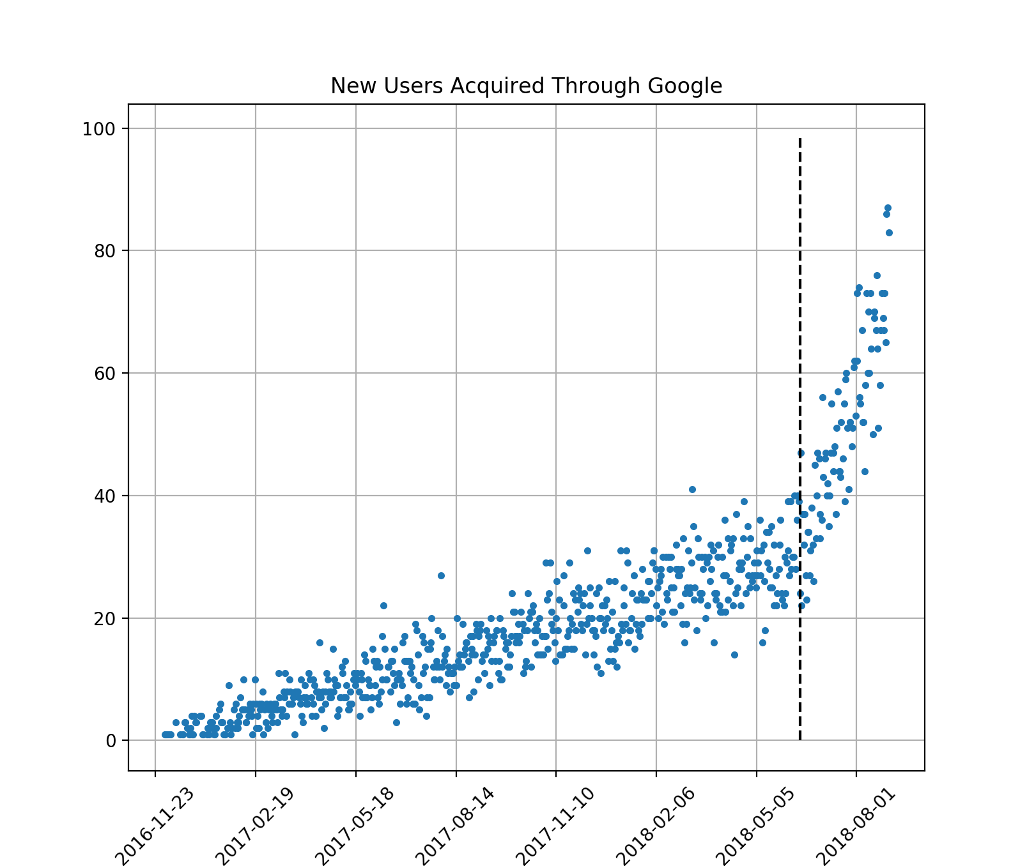
Search Engine Marketing
Plot on the right shows daily new-users from Google over all time.
Inflection point of daily new-users is clearly seen on 2018-05-04 (dashed vertical line) where search position changed.
Some Stats
Total marketing cost since change: $207,180
Total new users since change: 4604
Avg. post-change cost per account: $45.00
December 2018

Slide 10
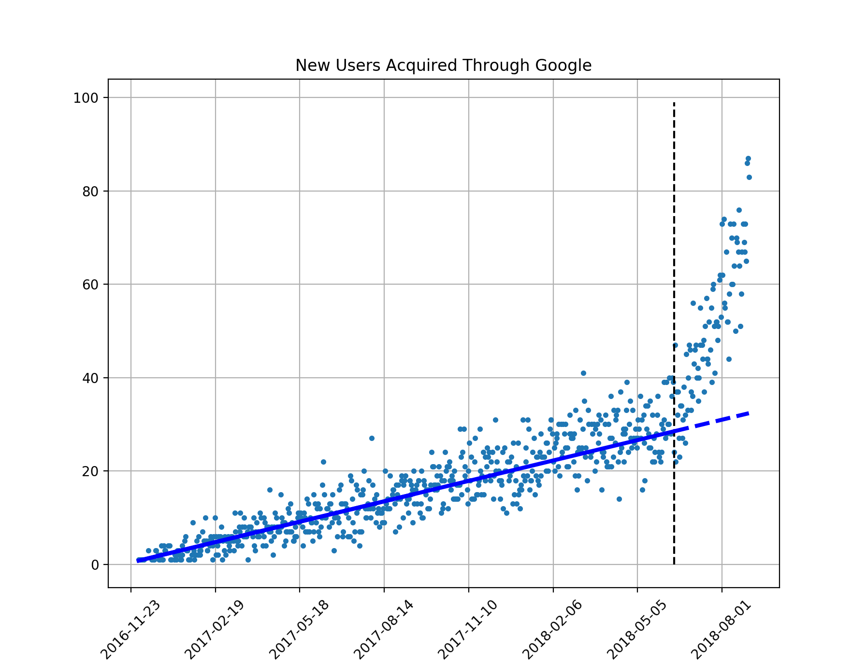

Search Engine Marketing
To estimate how many users would have been acquired if no changed occurred, I used a linear regression model to fit data before 2018-05-04 for prediction.
The model fit relatively well with an $r^{2}$ of about 0.85 (model accounts for roughly 85% of the data)
Some Stats
Estimated new users w/o change: 2,738
Estimated marketing cost w/o change: $82,140
Additional accounts created due to change: 1,866
Additional cost created due to change: $125,040
Marginal cost per additional account from change: $67.01
December 2018

Slide 11
Thank you!
December 2018

